Slide 1
Welcome to the life coaching course
BY GARGI ARYA

Slide 2
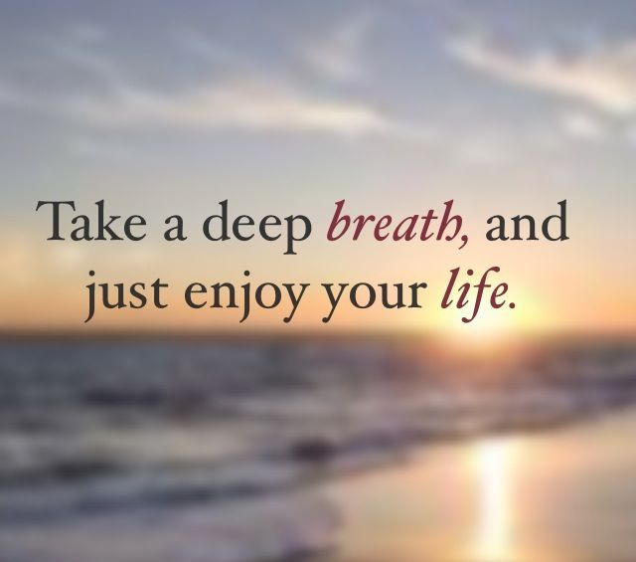
Before getting into this,

Slide 3
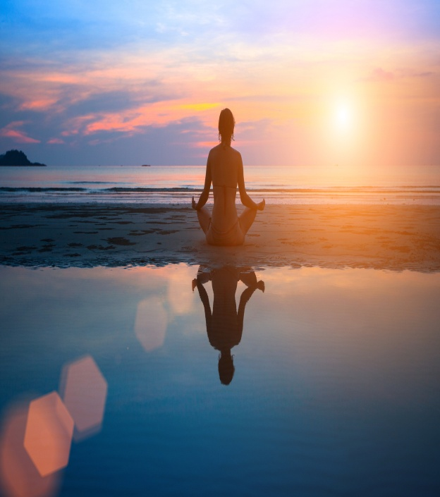
What Is Life About ?
“The purpose of our lives is to be happy”--- Dalai Lama
Life is not about proving anyone wrong
Life is about proving yourself right
Life is not about competing against others
But life is about competing against yourself
To make sure you are better than your previous self
Better than you were yesterday
To make sure you are growing every day
Developing, learning experiencing
Life is not about being perfect
It is about being happy
Not all the time
But every time you can.
Life isn’t about being right. It’s about being kind.
When you have a choice to be right or to be kind, choose
kindness, choose love.

Slide 4
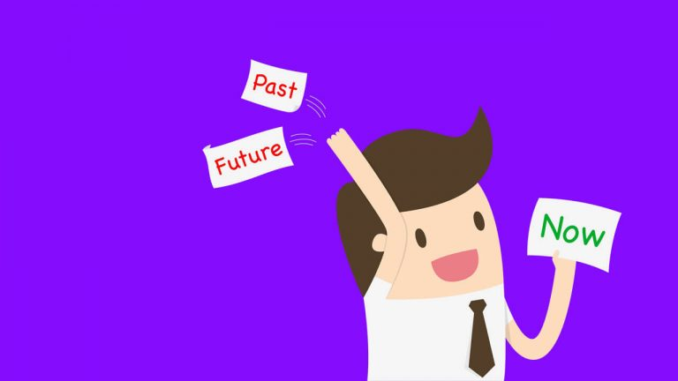
LIVE THE MOMENT
What’s really important is Who you become through all of
life’s challenges.
What you make and accumulate will never be a match for
Who you are and how much happiness you bring to this
world
Don’t ever forget that.
You are a miracle. This world is a blessing. Life is a miracle.
Life is really what you make it.
Live every day like you are blessed. Live every day as if you
are grateful to simply be alive. Be happy, no matter what
happens and life will be the amazing adventure it was meant
to be.

Slide 5
IT’S TIME TO WRITE YOUR GOALS

Slide 6
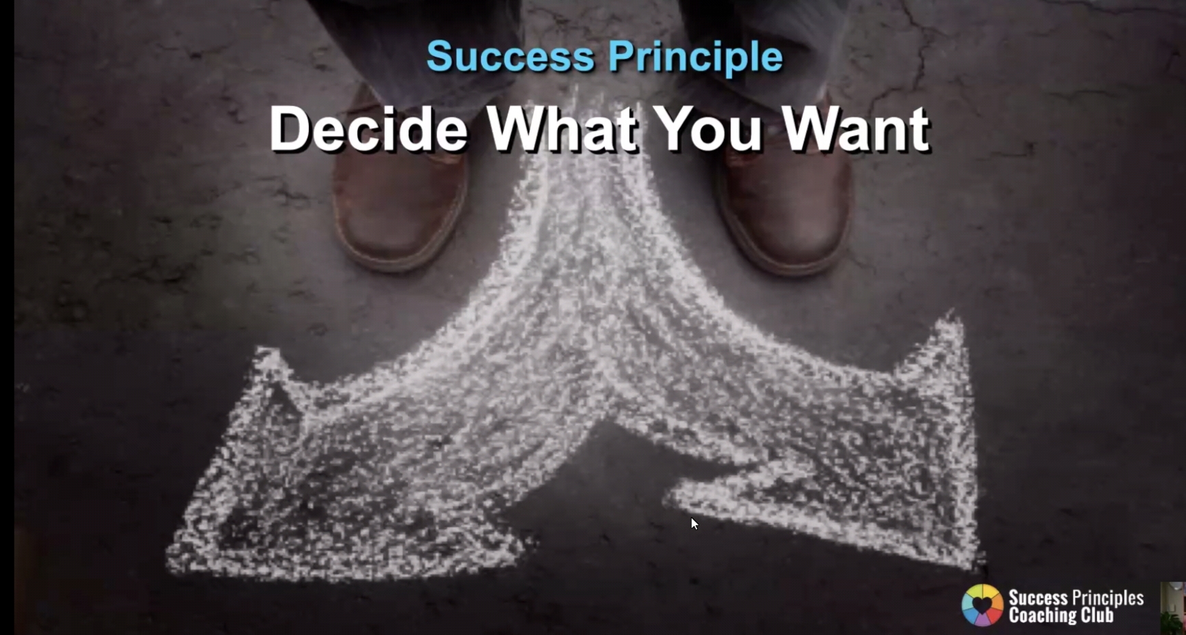
You Only Live Once, But if you do it right, once is enough !

Slide 7
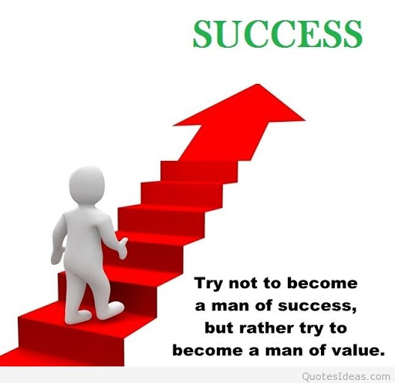
Now, It’s time to know the success principles
1. Take 100% Responsibility of Your Life
2. Be Clear Why You’re Here
3. Decide What You Want
4. Believe It’s Possible
5. Believe in Yourself
6. Use The Law of Attraction
7. Unleash The Power of Goal-Setting
8. Chunk It Down
9. Success Leaves Clues
10. Release The Breaks
11. See What You Want, Get What You See

Slide 8
Keep Reading !
12. Take Action
13. Just Lean Into It
14. Experience Your Fear And Take Action Anyway
15. Be Willing to Pay the Price
16. Ask! Ask! Ask
17. Reject Rejection
18. Use Feedback to Your Advantage
19. Commit to Constant and Never-Ending Improvement
20. Keep Score for Success
21. Practice Persistence
22. Exceed Expectations

Slide 9
PRACTICE THE LAW OF ATTRACTION
Law Of Attraction says that you will attract whatever you focus on in your life. Whatever you give your energy and attention to, will come back to you. So, if you stay focused on the good and positive things in your life, you will automatically attract more good and positive things in your life. However, on the other side if a person focuses on the negative things then, he will surely attract the negativity in his or her life. Suppose, if you are going through hard times, and you think that you are not strong enough to face them and you think that now, “I can’t take anymore.”

Slide 10
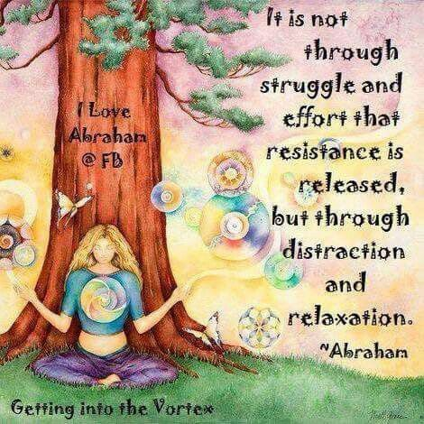
Keep Diving In !
Do you know the reason behind your thinking? The reason is that you are continuously focusing on the negative side of your life. My friend, wake up and fight. No one will fight for your life. You are responsible. Say to the obstacle that defeat is not your choice. You roar and flourish the face of danger. There is so much to smile about. And, here comes the role of Law Of Attraction. Have you ever heard the phrase “When life gives you lemons, make lemonade.” Do you know the meaning of this? The lemons here indicates the sourness or negativity in our life, and lemonade indicates the positive things. So, if I add up these two meanings together then I will have that When Life Hits You Hard, Instead of Focusing on the Problems Or Circumstances you are going through, [Lemons], Focus on The Positivity Of Life [lemonade].

Slide 11
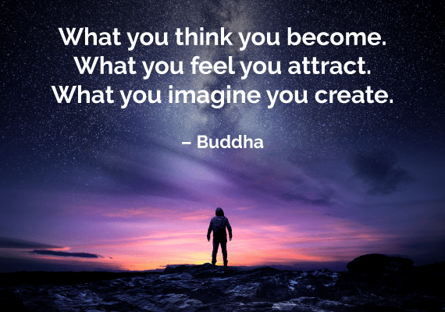
Yeah !
Give a motto to yourself like whenever I feel sad or depressed, I give myself a motto ‘HAKUNA MATATA’. It’s actually an East African word which means no trouble or no worries. I am sure you have heard this word before. So, give yourself a motto that will help you to look at positivity in your life. The Law Of Attraction helps you to look at positive things only.

Slide 12
Short Recap

Slide 13
Law Of Karma

Slide 14
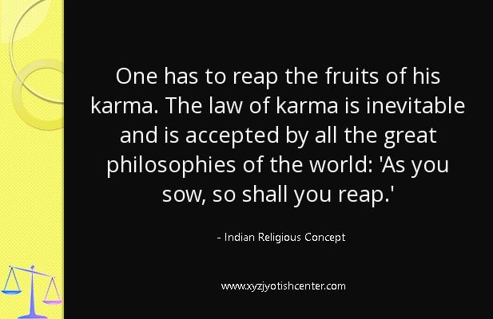
Nothing happens by chance or by fate, You create your own fate by your actions.. That’s Karma !

Slide 15
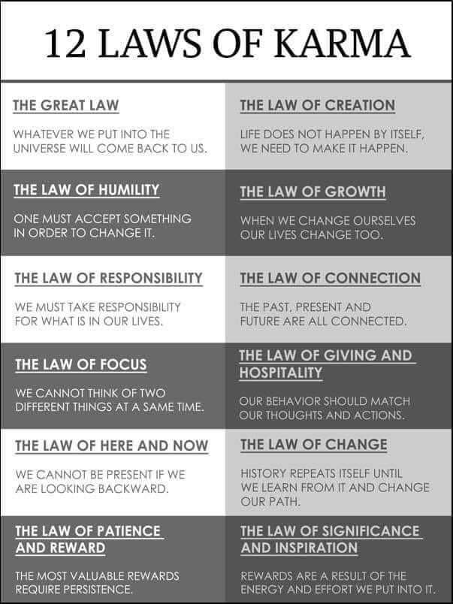
PRACTICE THEM..

Slide 16
IMPORTANCE OF MENTAL PEACE
Peace of mind is a state of being, a state achieved out of mental and emotional calmness.
In order to achieve peace of mind a person must have no fears, no worries and no stress.
In short, peace of mind is thinking about nothing other than feeling happy and relaxed in the moment.

Slide 17
How To Achieve Mental Peace ?
Peace of mind can be achieved by:
Limiting the amount of time you spend watching television, reading the news and checking social media.
All of these can cause stress and anxiety, so reducing the amount of time spent on these tasks can make it easier for peace of mind to be achieved.
Understanding that some things in life cannot be changed.
Rather than worrying about the things that are out of your control, focus on the parts of your life you can improve.
Slight irritations and inconveniences can be annoying, but if you allow them to go, it will help a lot.
Take the time to learn how to block other areas of life out using techniques such as meditation.
Trying not to focus on the things you don’t have and instead focus on the things you do have.

Slide 18
WHAT DO YOU WANT TO BECOME NOW ?
Yes, you read it right. I asked that what do you want to become now ? Life is too short to leave it for tomorrow. Take some rest, calm your mind, relax your body and then ask yourself that what do you want to become now ? Start working hard from today itself and then see your bright colours after some time. It’s never too late to say that ‘today is the day ! Let’s start a new life’. Don’t allow anyone to come in between you and your goals. Reject the rejections and don’t distract yourself....There will be many people who will tell you to stop and will distract you from working hard towards your goals, please don’t be trapped in their net. Learn the art of saying “NO”.. Stop wasting your time, start utilizing it ...Be an inspiration for others..Let them know who you are !
All the best !

Slide 19
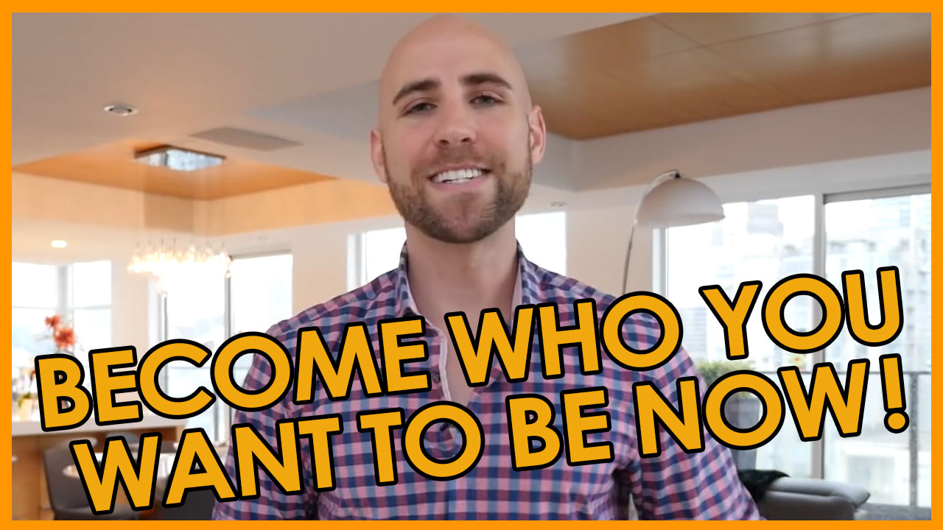
Start your new journey today !!

Slide 20
BEST OF LUCK ! BE THE BEST VERSION OF YOURSELF !

Slide 21
THANK YOU SO MUCH...HOPE YOU ENJOYED IT AND WILL START WORKING FROM TODAY ITSELF !

